Slide 1

"ITghurls"

Slide 2

Introduction to i need money - money problems

Slide 3
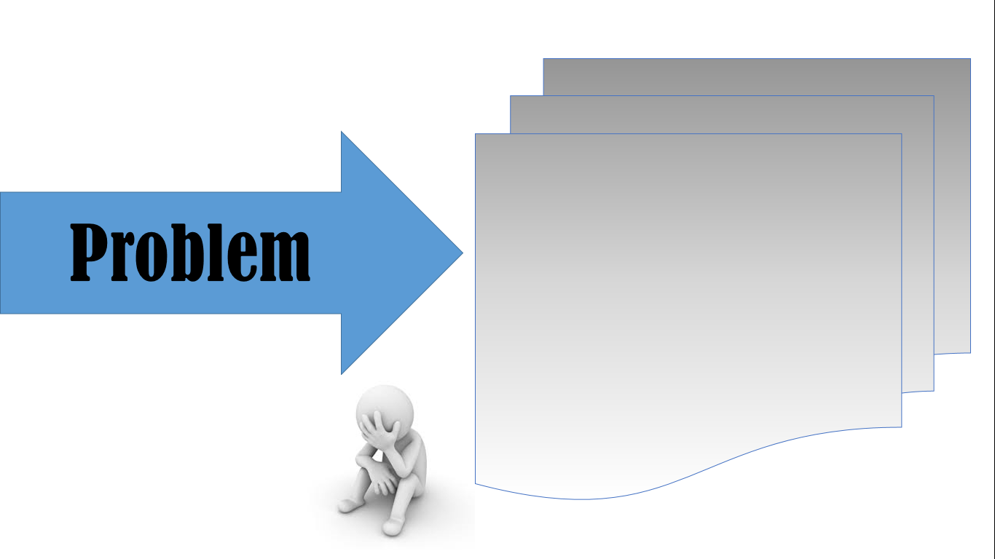
- i need money.. loads of them. -

Slide 4

"I need money" I need money - money problems

Slide 5

Benefits :
Features :
- test
- test

